Slide 1




UNIVERSITY OF NEW HAVEN
Course Number: DSCI-6007-01
COST-EFFECTIVE
REAL-TIME
RIDE SHARING
PLATFORM
Presented By: TEAM-2
Notes:
Sandeep:
Hello Everyone. We are so excited to present our project Cost effective real-time ride sharing platform.

Slide 2


UNIVERISITY OF NEW HAVEN
page 1 of 7
ABSTRACT
The project is a real-time data streaming platform to optimize ride-sharing service for university students. The project mainly emphasizes more on the infrastructure cost that helps the design to maintain and scale easily. By leveraging microservice architecture and pub-sub model, the system can handle and analyze real-time data more efficiently.
The project focuses on providing a convenient, affordable, and sustainable ride-sharing platform.
Notes:
Sandeep:
Imagine a scenario, where you have to travel to your friend's place. But, being a student, you need to manage your budget. So, booking an Uber where surge prices can be on anytime is not always budget friendly.
So, we came up with the idea of collaborating university and ride sharing to cut the ride costs.
With only essential services, the project can scale with minimal cost, directly resulting in low ride costs.
By leveraging microservice architecture and pub-sub model, the system can handle and analyze real-time data more efficiently.

Slide 3



UNIVERISITY OF NEW HAVEN
page 2 of 7
THE TEAM
AMRUTH KUNTAMALLA
SANDEEP RAJ KATIPAGALA
NAGASAI JAJA
Project Lead
Data Scientist
Data Analyst
Data Engineer
Notes:
Naga Sai:
Before diving deeper into business and technical aspects, we would like to quickly introduce our team:
Amruth being our project lead, he will be responsible to the infrastructure and data engineering part.
Sandeep will be focusing on analytics and machine learning aspects around price estimations.
Nagasai will be handing the client side integration to the backend and creating dashboards for analysis.

Slide 4
UNIVERISITY OF NEW HAVEN
page 3 of 7
BUSINESS SCENARIO: CHALLENGES
PRICING MODEL
CONSUMER DEMAND
INFRA COST
To be budget-friendly for the students as they run on a limited funds. However, low ride cost should cover fuel, driver pay and infra maintenance.
Consumer preferences are not static; they evolve constantly. Therefore, the scaling efficiently is a primary constraint
Running a real-time application costs thousands of dollars if misconfigured. If configured, services will be much more maintainable.
Notes:
Naga Sai:
Our biggest challenges concerning a new ride share application are displayed.
Mainly "a considerate pricing model", based on previous data, the data scientists must create a business model that is feasible for students and also maintains infra.
The other constraint is consumer demand:
consumer preferences are not static, they keep on chaning constantly. therefore, one needs to notify drivers about the demand to keep them on board and scale the infra accordingly.

Slide 5
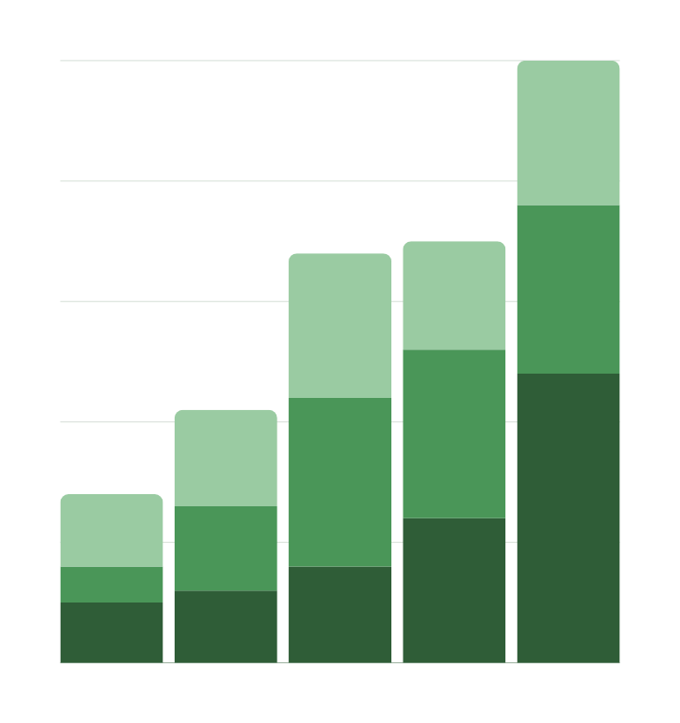
UNIVERISITY OF NEW HAVEN
page 4 of 7
BUSINESS SCENARIO
To create a platform that provides students a budget-friendly option to commute.
Build a scalable data infrastructure that costs almost negligible to start and keep services up and running.
Calculate the cost of each ride based on the previous available data using statistical analysis.
If applicable, budget for marketing and promotional expenses to showcase the project and attract funding and charity and partner with local businesses to offer in-app advertising.
Consider any other costs specific to the project, such as fuel, driver wage, or infrastructure cost.
Notes:
Sandeep:
Building a scalable data infrastructure that costs almost negligible to start and keep services up and running.
If applicable, budget for marketing and promotional expenses to showcase the project and attract funding and charity and partner with local businesses to offer in-app advertising.

Slide 6

UNIVERISITY OF NEW HAVEN
page 5 of 7
SOLUTION OVERVIEW
A well-configured platform that can leverage the advantages of Pub-Sub model and microservice architecture. By connecting students with available drivers, we offer a convenient, affordable, and sustainable transportation option.
Using real-time analytics, the service can track and update driver locations. With the help of Apache Kafka, the load is evenly distributed to available services without overloading the backend servers.
Notes:
Amruth:
Let's now dive into the technical part of the project:
Here, the project heavily relies on the advantages of Pub - Sub model and micro service architecture. Using large-scale analytical engine, the service can track and save the drive locations for the future analytics. With the help of pub-sub model in Apache Kafka, the notifications to client side can be sent easily.

Slide 7
UNIVERISITY OF NEW HAVEN
page 6 of 7
01
02
03
DATA ENGINEERING
DATA CLEANSING & INTERGRATION
DATA ANALYTICS
Setting the infra keeping cost in mind.
Discuss changing consumer preferences and the need to adapt to evolving trends.
Infrastructure and data engineering
Configuring data pipelines to provide fast response while working with real-time data.
Implementing the business logic - cost estimation based on previous data ingested from Kaggle or Uber’s official websites. and predict prices for the new parameters.
Notes:
Here, we mentioned the roles and responsibilities of each member and how all the services can be integrated to make the final product.
We believe, configuring each service properly would be the key to build a scalable system.

Slide 8











ARCHITECTURE DIAGRAM
page 7 of 7
Backend Server
Event Handler
Pub/Sub
Client
Price Prediction
Models
Driver
+
Kafka UI
Dashboards
Transactional DB
Analytical DB
Project GitHub Link:
https://github.com/amruth-k99/ride-sharing-platform
Notes:
Coming to architecture and system design,
We have made a tentative plan.
We are planning to use AWS cloud to deploy all the services.
The architecture might change based on the budget constraints. if any service was found to be better and cost effective, they will be replaced.
With this, we conclude our presentation.
Thank you so much from the entire team.

